Slide 1
Unit - 2

Slide 2
Research Problem: Research Problem, Selecting the Problem, Necessity of Defining the Problem, Technique Involved in Defining a Problem, An Illustration.
Reviewing the literature: Place of the literature review in research, bringing clarity and focus to research problem, improving research methodology, broadening knowledge base in research area, enabling contextual findings, Review of the literature, searching the existing literature, reviewing the selected literature, developing a theoretical framework, developing a conceptual framework, writing about the literature reviewed.

Slide 3
Research Problem
In research process, the first and foremost step happens to be that of selecting and properly defining a research problem.
A researcher must find the problem and formulate it so that it becomes susceptible to research.
Like a medical doctor, a researcher must examine all the symptoms (presented to him or observed by him) concerning a problem before he can diagnose correctly. To define a problem correctly, a researcher must know: what a problem is?

Slide 4
WHAT IS A RESEARCH PROBLEM?
A research problem, in general, refers to some difficulty which a researcher experiences in the context of either a theoretical or practical situation and wants to obtain a solution for the same.

Slide 5
The key components necessary for a research issue to exist and be studied systematically:
Existence of an Entity (Individual/Group/Organization):
The problem must be linked to a particular individual or organization (denoted as ‘I’).
This entity exists in a specific environment (‘N’), characterized by uncontrolled variables (Yj).
Availability of Alternative Courses of Action:
At least two options (C1 and C2) must be present.
These options represent different values of controlled variables (i.e., decisions that can be made).
Different Possible Outcomes:
There must be at least two outcomes (O1 and O2), with one being preferable to the other.
The existence of a preferred outcome establishes the research objective.
Unequal Probabilities of Success:
Each course of action must have a different probability of achieving the objective.
If all options had the same probability of success, there would be no research problem, as the choice wouldn’t matter.

Slide 6
Example 1: Business Decision-Making
Scenario:
A retail company (‘I’) is experiencing declining sales in a competitive market (‘N’).
Conditions of a Research Problem:
Entity (‘I’) and Environment (‘N’):
The company (I) operates in a market (N) where customer preferences are shifting.
Two Courses of Action (C1 and C2):
C1: Launch a new product line.
C2: Increase marketing efforts for existing products.
Possible Outcomes (O1 and O2):
O1: Increased revenue and market share.
O2: Continued decline in sales.
Unequal Probabilities:
The probability of success (P(Oj | I, Cj, N)) differs for each option, meaning research is required to determine which strategy is more effective.

Slide 7
Defining the Research Problem
A research problem arises when an individual or organization faces a difficulty and is uncertain about the best course of action to achieve a desired outcome.
The problem must involve multiple alternatives with varying efficiencies and require research to determine the optimal solution.

Slide 8
Key Components of a Research Problem:
Existence of a Problem: There must be a difficulty faced by an individual or group.
Defined Objectives: The problem must have specific goals to be attained.
Alternative Courses of Action: At least two possible solutions should exist.
Uncertainty in Decision-Making: The researcher must be unsure about the best alternative.
Relevant Environment: The problem must exist within a specific context that influences outcomes.

Slide 9
Example of a Research Problem
Scenario: Improving Employee Productivity in Remote Work
1. Existence of a Problem: A company notices a decline in employee productivity after shifting to remote work.
2. Defined Objective: The company wants to improve employee productivity while maintaining remote work flexibility.
3. Alternative Courses of Action:
C1: Implement strict monitoring software to track work hours.
C2: Introduce flexible work schedules with performance-based evaluations.
4. Uncertainty in Decision-Making: The management is unsure which approach will be more effective in improving productivity without affecting employee morale.
5. Relevant Environment: The issue exists within the remote work setup, influenced by factors like work-life balance, employee engagement, and technological tools.

Slide 10
Selecting the Research Problem
Selecting a research problem is a crucial and challenging task that requires careful consideration. While guidance from experts can be helpful, the final choice must come from the researcher to ensure originality and genuine interest.

Slide 11
Key Guidelines for Selecting a Research Problem:
Avoid Overdone Topics – A well-researched subject may not offer new insights.
Avoid Highly Controversial Topics – They can be complex and difficult to analyze objectively.
Ensure Clarity and Scope – Problems should neither be too narrow nor too vague.
Choose a Familiar and Feasible Topic – Availability of research material and expert guidance is essential.
Assess Practical Considerations:
Researcher’s qualifications and expertise
Budget constraints
Availability of cooperation from participants
Conduct a Preliminary Study – A feasibility study is necessary, especially for new fields with undeveloped research methods.

Slide 12
Necessity of Defining the Research Problem
A well-defined research problem is crucial, as a clearly stated problem is half solved. Proper definition helps in:
Distinguishing relevant data from irrelevant data
Ensuring a focused research approach
Determining what data to collect and analyze
Identifying relationships to explore
Selecting appropriate research techniques
Without clear problem definition, research may face hurdles and inefficiencies.
Problem formulation is often more important than finding the solution, as it lays the foundation for research design and smooth execution of subsequent steps.

Slide 13
Techniques Involved in Defining a Research Problem
Defining a research problem involves setting clear boundaries for study with a predetermined objective. It is a crucial and systematic process that requires careful consideration.
The following steps are involved:
Statement of the Problem in a General Way
Understanding the Nature of the Problem
Surveying Available Literature
Developing Ideas through Discussions
Rephrasing the Research Problem

Slide 14
Statement of the Problem in a General Way
The problem should be stated broadly, considering practical or intellectual concerns.
Preliminary surveys or expert guidance can help refine the problem statement.
Understanding the Nature of the Problem
The researcher should explore the origin and background of the problem.
Discussions with experts and understanding the research environment are essential.
Surveying Available Literature
Reviewing existing theories, reports, and studies helps refine the problem.
Identifies gaps, inconsistencies, and potential difficulties in research.
Developing Ideas through Discussions
Engaging with experienced researchers and peers can generate new insights.
Discussions help refine research focus and possible methodologies.
Rephrasing the Research Problem
The problem should be rewritten in specific analytical terms.
This makes it operationally viable and helps in formulating working hypotheses.

Slide 15
Illustration of Defining a Research Problem
The process of defining a research problem involves refining a broad question into a precise and researchable statement.
This can be illustrated with an example:
Initial Broad Question:
“Why is productivity in Japan so much higher than in India?”
This statement is too uclear, as it lacks clarity on productivity type, industries, and time period.

Slide 16
Refined Question:
“What factors were responsible for the higher labour productivity of Japan’s manufacturing industries during the decade 1971 to 1980 relative to India’s manufacturing industries?”
This version removes ambiguities and focuses on specific industries and time periods.
Final Specific Question:
“To what extent did labour productivity in 1971 to 1980 in Japan exceed that of India in respect of 15 selected manufacturing industries? What factors were responsible for the productivity differentials between the two countries by industries?”
This version is well-defined, includes measurable aspects, and specifies industries and timeframes.

Slide 17
Reviewing the literature: Place of the literature review in research, bringing clarity and focus to research problem, improving research methodology, broadening knowledge base in research area, enabling contextual findings, Review of the literature, searching the existing literature, reviewing the selected literature, developing a theoretical framework, developing a conceptual framework, writing about the literature reviewed.

Slide 18
Place of the literature review in research
What is a Literature Review?
A process of reviewing existing knowledge in your area of interest
Time-consuming but rewarding
A vital part of the research journey
Helps in clarifying ideas and refining the research question

Slide 19
The Role of Literature Review in Research
Literature Review's Integral Role
Provides a theoretical foundation for the study
Links your research with prior studies
Supports or contradicts existing research findings
Enhances knowledge and methodology throughout the study

Slide 20
Pre-Research Benefits
Early Stages of Research
Establish Theoretical Roots
Clarifies the research problem and idea development
Helps in formulating the research question
Develops research methodology
Later Stages of Research
Consolidates Knowledge Base
Enhances integration of new findings with existing knowledge
Helps in comparison with previous research
Essential for higher-level academic research

Slide 21
Key Functions of Literature Review
Theoretical Background: Provides a foundation for the study
Links to Existing Research: Connects your study with previous findings
Contribution to Knowledge: Shows how your findings add to the field
Contextualization: Places your findings in the wider academic context

Slide 22
Place of the literature review in research
Literature Review's Contribution to Your Study
How Literature Review Enhances Your Research
Clarity and Focus: Helps define the research problem
Improves Methodology: Guides your research approach
Broadens Knowledge: Deepens understanding of the topic
Contextualization of Findings: Relates your results to broader knowledge

Slide 23
Bring clarity and focus to your research problem
The Paradox of Literature Review
Paradox: You need a research problem to begin the literature review, but the review helps shape and clarify the problem.
Literature review both guides and refines the problem you wish to investigate.
Literature Review Shapes Your Research Problem
Improves Understanding
Helps you understand the subject area better.
Provides insight into what has already been studied.
Conceptualization
Helps you conceptualize the research problem clearly and precisely.
Makes the problem relevant to your field of inquiry.

Slide 24
Insights from the Literature Review
What has been studied?
Identify aspects of the topic previously explored.
What were the findings?
Learn about key discoveries and conclusions.
What are the gaps?
Discover gaps in the existing knowledge and areas for further research.
What are the suggestions for further research?
Use suggestions to refine your research questions and objectives.

Slide 25
Improves Methodology
The Literature Review Informs Methodology
Understanding Existing Methodologies
The literature review exposes you to the methods and procedures used by others in similar studies.
Learn what methodologies have been effective and why
Identifying What Works and What Doesn’t
What’s Worked Well
Discover which methods and procedures have been successful in answering similar research questions.
Common Problems
Understand the challenges and pitfalls others have faced in using these methods.
Learn from their experiences and adjust your methodology accordingly.

Slide 26
Strengthening Your Methodology Choice
Informed Decision-Making
Reviewing the literature helps you select a methodology that is most likely to provide valid answers to your research question.
Confidence and Defense
By understanding the strengths and weaknesses of existing methods, you can defend and feel confident about your own chosen methodology.

Slide 27
Broadening your knowledge base in your research area
Broadening Your Knowledge
Literature review ensures you read widely across your subject area.
Explore what others have found regarding similar research questions.
Understand existing theories and gaps in knowledge.
Expertise Requirement
For higher degrees (MA, PhD), you are expected to be an expert in your research area.
A thorough literature review helps fulfill this expectation by broadening your understanding.
Contextualizing Your Research
A literature review helps you understand how your findings fit into the existing body of knowledge.
This connection enhances the relevance and impact of your research.

Slide 28
Enabling you to contextualise your findings
The Challenge of Fitting Your Findings into Existing Knowledge
Obtaining Answers is Easier
The easy part of research is finding answers to your questions.
The Difficult Part
The difficult task is examining how your findings fit into the existing body of knowledge.
Key Questions to Consider
Comparison with Previous Findings
Contribution to Knowledge
Difference from Others

Slide 29
Literature Review Helps Contextualize Findings
Comparing Findings:
Literature review allows you to compare your findings with those of others.
Answering Key Questions:
Helps you answer the critical questions of how your findings fit into the broader field.

Slide 30
How to review the literature
There are four steps involved in conducting a literature review:
1. Searching for the existing literature in your area of study.
2. Reviewing the selected literature.
3. Developing a theoretical framework.
4. Developing a conceptual framework.

Slide 31
Searching for the existing literature in your area of study
To search effectively for the literature in your field of enquiry.
This helps set parameters for your search.
The three primary sources to compile a bibliography:
Books
Journals
Internet

Slide 32
Books
Searching and Organizing for Your Bibliography
Advantages:
Books often contain high-quality material that integrates research findings into a cohesive body of knowledge.
Disadvantages:
Books may not be completely up to date, as there is often a time gap between completing research and publishing it in book form.

Slide 33
Steps for Searching Books:
Use Library Catalogs:
Search for books through your library's catalog.
Librarians assign subject headings based on systems like the Library of Subject Headings, which helps narrow your search.
If unsure, ask your librarian for guidance on the best subject headings for your research area.
Search by Subject or Keywords:
Use the subject catalog or keyword search option to find books related to your research.
Narrow your search by selecting appropriate keywords to refine your results.
Review book titles carefully to assess their relevance to your topic.
Examine the Contents:
Titles alone may not give enough insight, so check the book's contents to decide if it's useful.
If available, print out the book’s details or jot down important information for future reference.
Compile a List of Relevant Books:
Narrow down your list to 10-15 books you think are most relevant.
Examine the bibliographies of these books. Copying the bibliographies can save time.
Identify frequently cited books across multiple sources. Books referenced by several authors should be included in your reading list.
Finalize and Locate the Books:
Obtain the books from your library or through interlibrary loans.
Check their contents to ensure relevance to your research. Remove any books that don’t align with your topic.
Create an Annotated Bibliography:
For each book, create an annotated bibliography with a brief summary of its key aspects and how it relates to your research.
Keep track of all references using a card index or reference management tools like Endnote or Pro-Cite.

Slide 34
Journals
Advantages:
Journals provide the most up-to-date research, although there may still be a 2-3 year delay between the completion of research and its publication.
They are essential for staying current in your field of study.

Slide 35
Steps for Searching Journals:
Select Relevant Journals:
Identify as many journals as possible that are relevant to your research. The number of journals available will depend on your field of study—some fields have more journals than others.
Prepare a list of journals to examine.
Search Methods:
Locate Hard Copies: Find physical copies of relevant journals.
Use Citation/Abstract Indices: Search through citation indices or abstract services (e.g., Humanities Index, ERIC, Social Sciences Citation Index) to identify relevant articles and abstracts.
Search Electronic Databases: Use online databases to locate articles in digital format.
Examine Journal Issues:
Start with the latest issue of a journal and examine its contents page.
If a relevant article is identified, read the abstract to confirm its usefulness.
Depending on resources, either photocopy the article or create a summary, recording its reference for later use.
Efficient Tools for Searching:
Indices of Journals (e.g., Humanities Index) help locate relevant journals.
Abstracts of Articles (e.g., ERIC) provide brief summaries of articles.
Citation Indices (e.g., Social Sciences Citation Index) identify frequently cited articles, offering insight into influential studies.
Use Electronic Databases:
Many libraries offer electronic databases with specialized tools for searching books, journals, and abstracts.
These databases often classify information by subject, author, title, and keywords.
Choose the most appropriate database for your area of study.
Talk to Experts:
Consult your research supervisor or other experts to identify additional relevant journals and articles you may have missed.

Slide 36
Internet
The Internet is a crucial tool for quickly finding published literature in books, journals, and other sources.
Internet searches, primarily using search engines like Google and Yahoo, rely on keywords.
The search engine identifies material containing those keywords, either individually or in combination. It's important to use terms others are likely to search for.
Additionally, most search engines use Boolean logic with three operators: AND (to combine terms), OR (to include either term), and NOT (to exclude a term).
With practice, you can refine your searches to find the most relevant material.

Slide 37
Reviewing the selected literature
While going through the
Literature you should carefully and critically examine it with respect to the following aspects:
Note whether the knowledge relevant to your theoretical framework has been confirmed beyond doubt.
Note the theories put forward, the criticisms of these and their basis, the methodologies adopted (study design, sample size and its characteristics, measurement procedures, etc.) and the criticisms of them.
Examine to what extent the findings can be generalised to other situations.
Notice where there are significant differences of opinion among researchers and give your opinion about the validity of these differences.
Ascertain the areas in which little or nothing is known – the gaps that exist in the body of knowledge.

Slide 38
Developing a theoretical framework
Literature review can be overwhelming due to its limitlessness.
Focus on setting parameters around key themes related to your research topic.
Èxample : Social Media Usage Patterns
Frequency and duration of use.
Types of platforms used (e.g., Instagram, TikTok, Facebook).
Limit the scope to relevant theories, concepts, and trends.

Slide 39
Importance of Identifying Key Themes
The research problem often connects to multiple theories from different perspectives.
Review literature by sorting it into main themes and theories.
Look for agreements, disagreements, and gaps in the literature.
Role of Theoretical Framework
Theoretical framework guides the literature review process.
Framework helps organize literature and highlight relevant aspects for your research.
Without a framework, you may get lost in irrelevant reading and note-taking.

Slide 40
Challenge
Can't fully develop a framework without reviewing literature, and vice versa.
Solution: Start by reviewing some literature and create a preliminary framework.
Refine the framework as more literature is reviewed.
Types of Information in Literature
Universal Information:
General theories and ideas applicable broadly.
Specific Information:
Local trends or details of a particular programme that relate directly to your study.

Slide 41
Organizing Literature for Framework
Start with general (universal) information.
Gradually narrow down to specific aspects relevant to your research.
Sort literature according to the themes and theories within your framework.

Slide 42
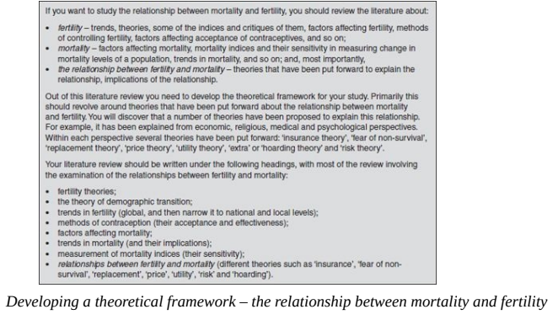

Slide 43
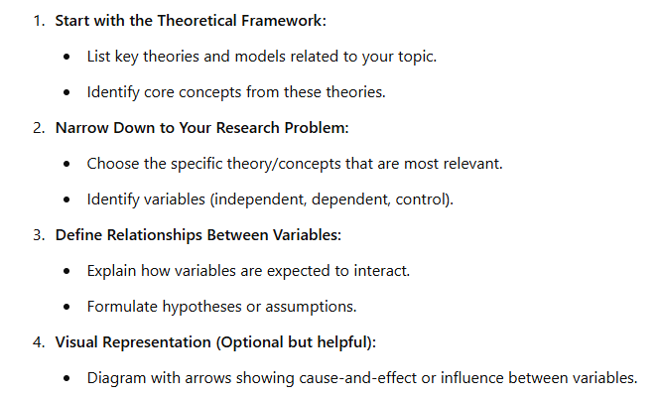
Developing a conceptual framework
The conceptual framework is the basis of your research problem.

Slide 44

Example:
Does Daily Exercise Improve Mental Health in College Students?
Conceptual Framework
Independent Variable: Daily Exercise (measured in minutes per day)
Dependent Variable: Mental Health (measured by stress levels, anxiety scores, or self-reported well-being)
Assumed Relationship: More daily exercise → Better mental health

Slide 45
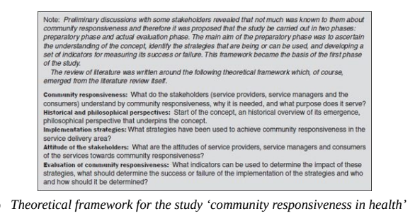

Slide 46
Writing About the Literature Reviewed
Main Functions of a Literature Review:
Provide Theoretical Background (Done before your research)
Identify and describe theories related to your topic.
Highlight gaps in existing knowledge.
Note recent advances and current trends.
This sets the foundation for your conceptual and theoretical frameworks.
Contextualize Your Findings (Done after your research)
Compare findings with existing studies.
Show how results confirm, contradict, or expand on past research.

Slide 47
Steps for Writing the Literature Review (Before Research)
Read Widely and Identify Themes
Reeding helps to identify certain themes or topics.
These themes form the basis of your subheadings in the literature review.
Organize with Subheadings
Use precise, descriptive subheadings to structure your review.
Example: For a study on intercountry adoption, subheadings could be:
Legal Frameworks
Ethical Concerns
Adoption Outcomes
Cultural Impacts
Write Thematically Under Each Subheading
Summarize key findings for that theme.
Highlight agreements/disagreements between authors.
Identify gaps or unanswered questions in the literature.

Slide 48
Example of a Subheading Structure for Your Topic (Fertility and Mortality):
Theories on Fertility Behavior
Theories on Mortality and Its Impact
Fear of Non-Survival Theory
Socioeconomic Influences on Fertility and Mortality
Gaps in Research: Fear of Non-Survival in Different Cultures

Slide 49
Sampling
Sampling is the process of selecting a subset of individuals or items from a larger group (called the population) in order to gather information and make inferences about the whole population without studying everyone.
Deliberate sampling
Simple random sampling
Systematic sampling
Stratified sampling
Quota sampling
Cluster sampling and area sampling
Multi-stage sampling
Sequential sampling

Slide 50
1. Deliberate Sampling (Purposive Sampling)
Definition: Researchers deliberately select specific individuals or groups based on certain characteristics or knowledge.
Use Case: When studying experts or specific cases, not generalizing to the whole population.
2. Simple Random Sampling
Definition: Every individual has an equal chance of being selected.
Method: Use random number generators, lotteries, etc.
Use Case: When the population is homogeneous and a completely unbiased sample is needed.
3. Systematic Sampling
Definition: Select every kth item from a list after a random starting point.
Example: Choose every 10th person on a list of 1,000 people.
Use Case: When a complete list exists, and sampling needs to be simpler than random.
4. Stratified Sampling
Definition: Divide the population into groups and randomly sample from each.
Example: Divide by age, gender, or income level.
Use Case: Ensures representation from each subgroup, especially when groups vary.

Slide 51
5. Quota Sampling
Definition: Select a sample with specific quotas for certain traits, but selection within quotas is non-random.
Example: Interview 50 men and 50 women, but choose whoever’s available.
Use Case: Similar to stratified, but used in market research where random selection isn't feasible.
6. Cluster Sampling and Area Sampling
Cluster Sampling: Divide the population into clusters (e.g., schools, neighborhoods), randomly select clusters, and study all or some members within them.
Area Sampling: A type of cluster sampling where clusters are geographic areas.
Use Case: When populations are widespread or it's costly to sample individuals randomly.
7. Multi-Stage Sampling
Definition: Combine several sampling methods in stages.
Example: First cluster sample, then random sample within clusters.
Use Case: For large-scale surveys (e.g., national studies) to manage cost and complexity.
8. Sequential Sampling
Definition: Sampling is done in phases, and decisions are made after each phase whether to continue or stop.
Use Case: Often used in quality control or clinical trials where early results inform next steps.

